Slide 1
The Modeling Process
Groundwater Flow and Solute Transport Modeling
August 20-23, 2018
Port Hueneme, California
Langevin, Hughes, Paulinski

Slide 2
What is a model?
Mathematical models
Analytical models
Numerical models
Physical models
Electric analog models

Slide 3
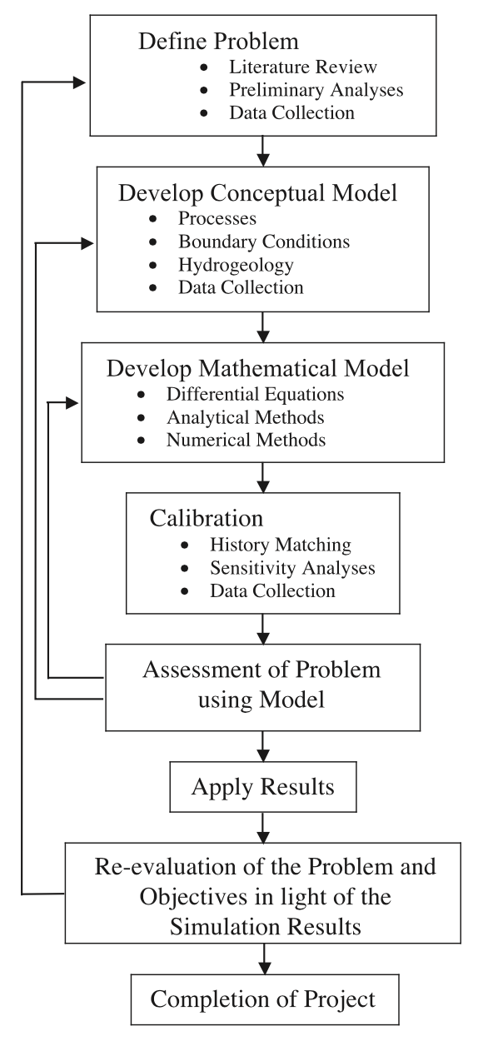
Modeling Process
Define Objectives
Conceptual Model
Mathematical Model
Model Design
Calibration
Forecast
Document

Slide 4
Recommended Reading

Slide 5
Define Objectives

Slide 6
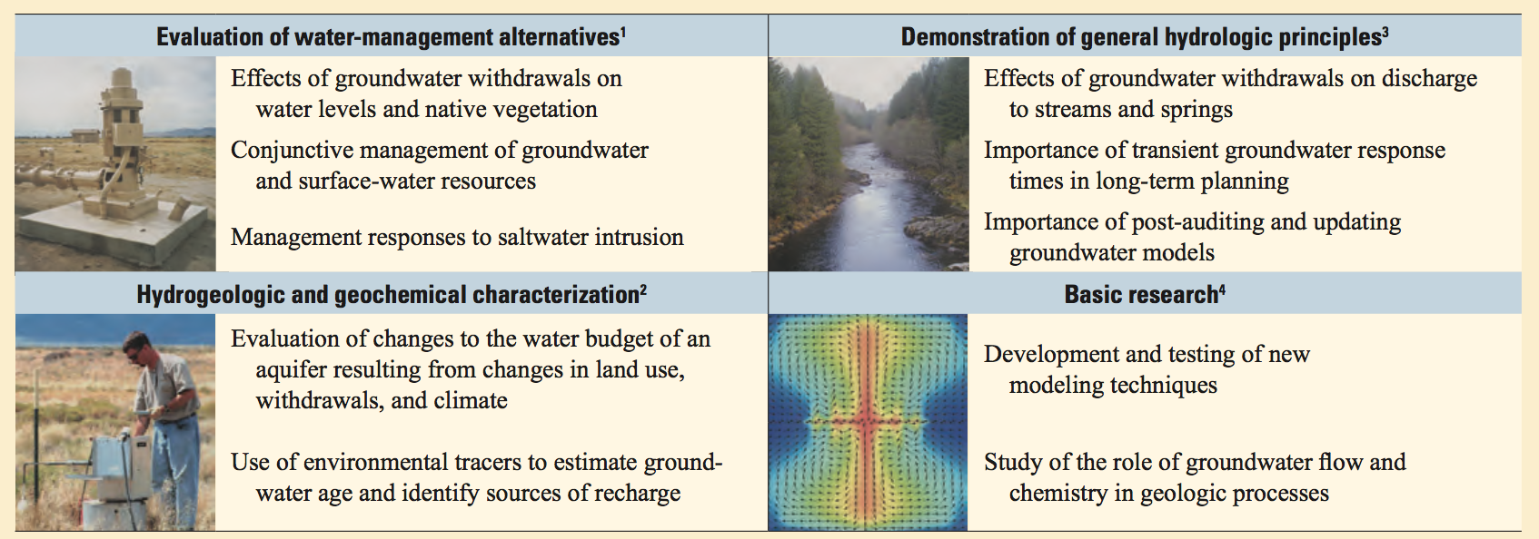
Why do we model?
Define the purpose

Slide 7
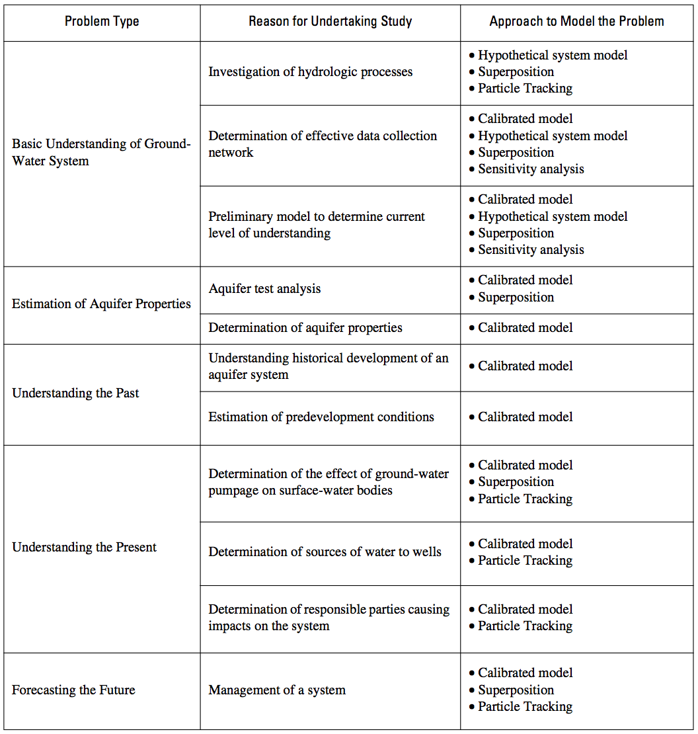

Slide 8
Groundwater Flow Equation

Slide 9
Types of Numerical Models
Finite Volume
Finite Element

Slide 10
Important Considerations
Steady state or Transient
Scale
Resolution
Dimensionality

Slide 11
Conceptual Model

Slide 12
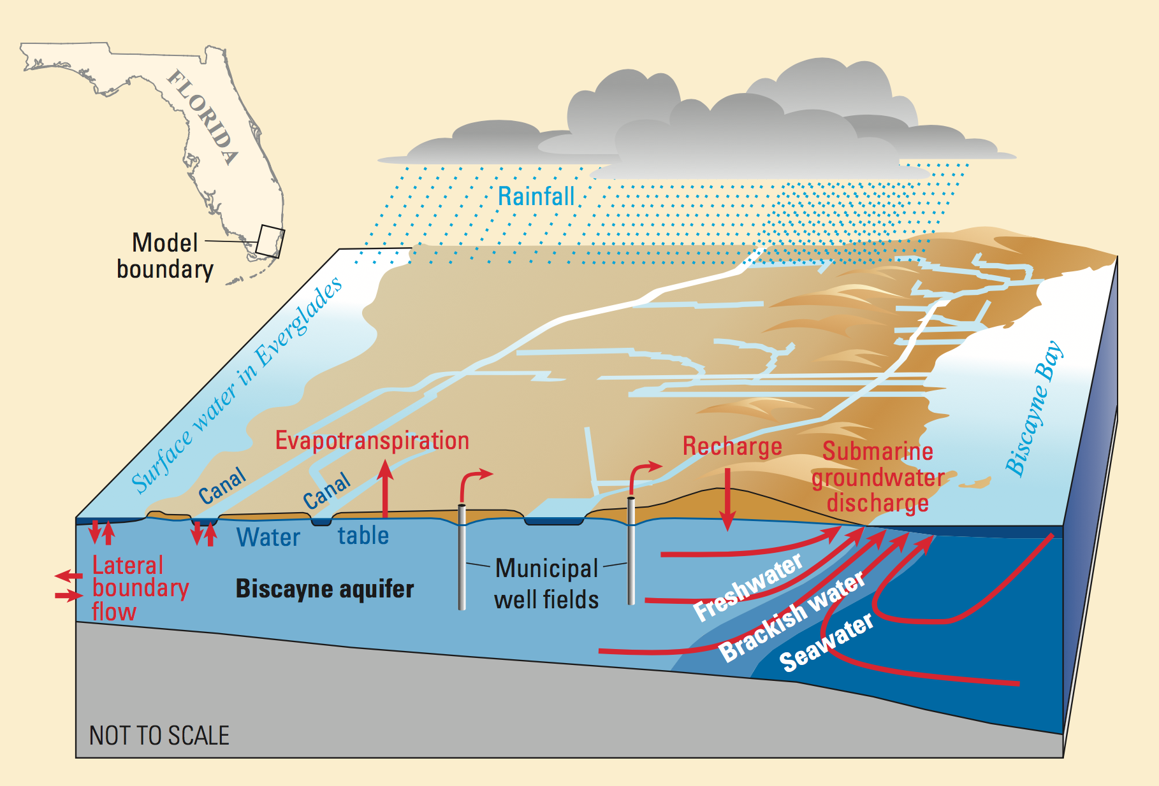
Conceptual Model

Slide 13
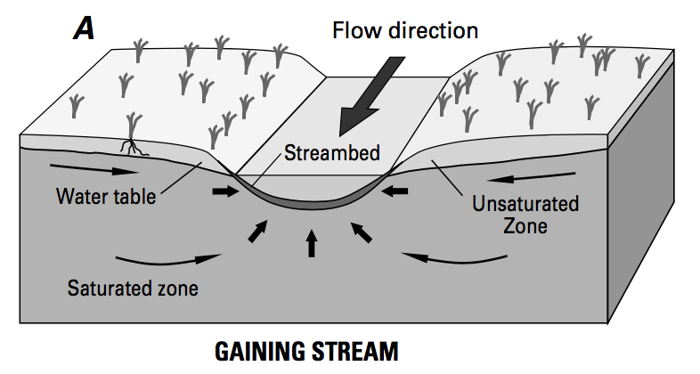
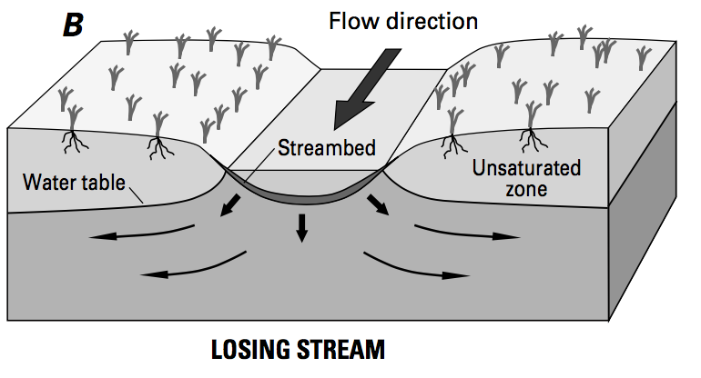
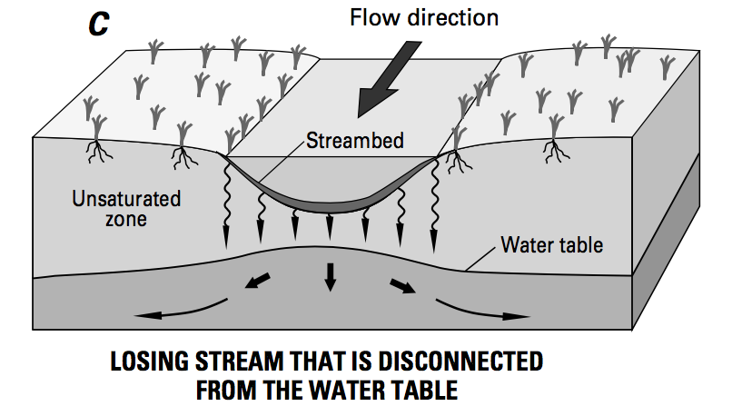
Conceptual Model

Slide 14
Mathematical Model

Slide 16
Model Design

Slide 17
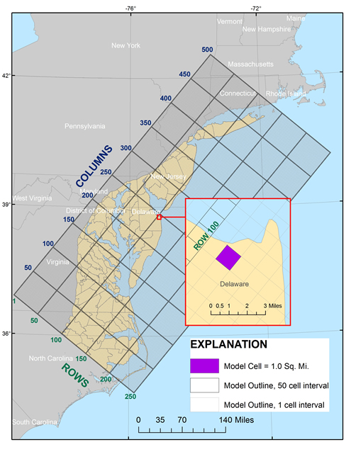
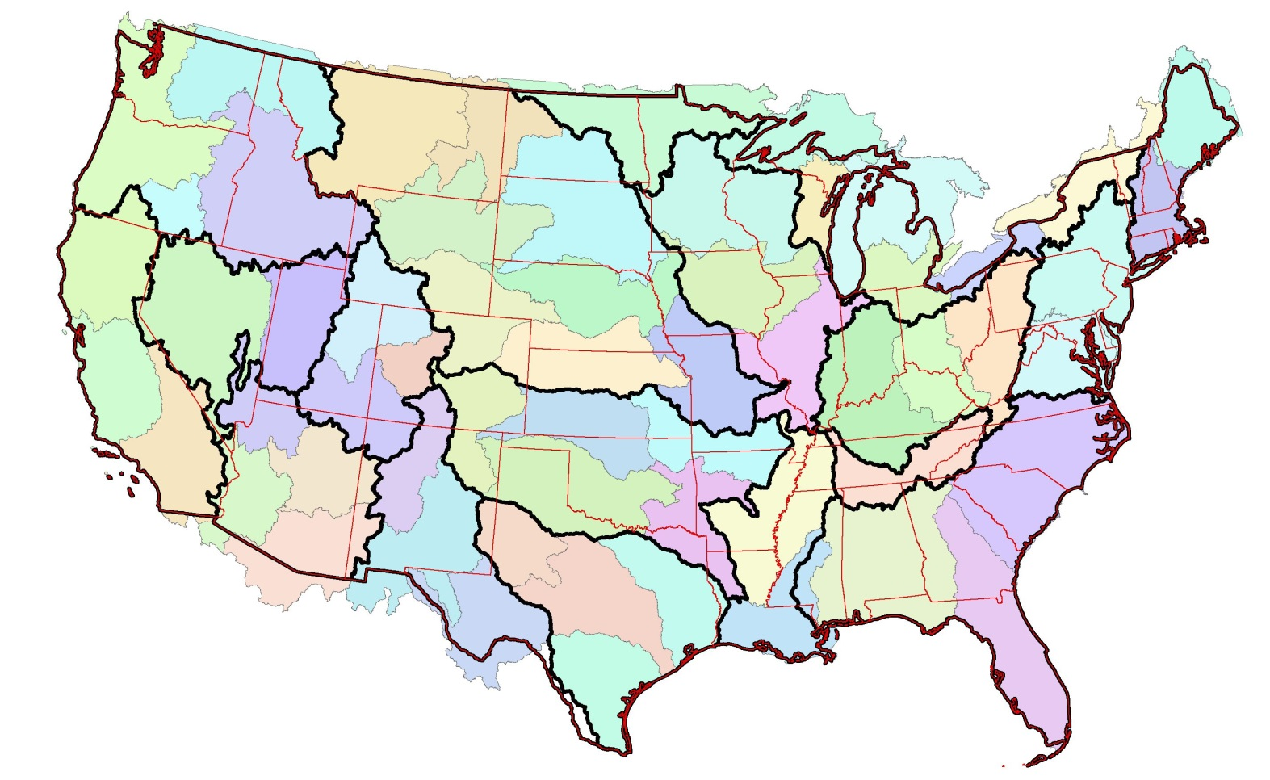
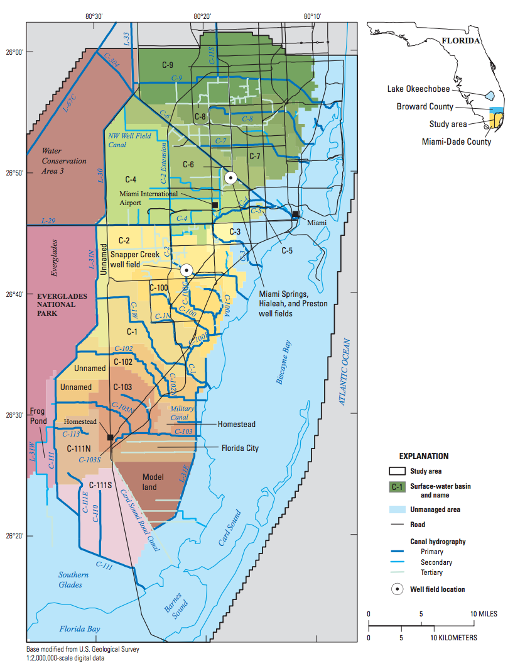
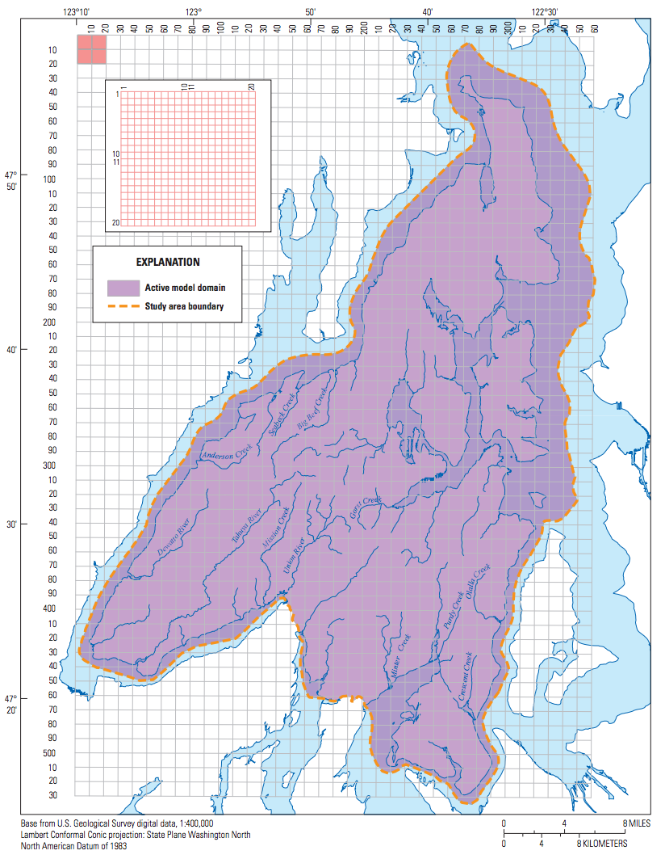
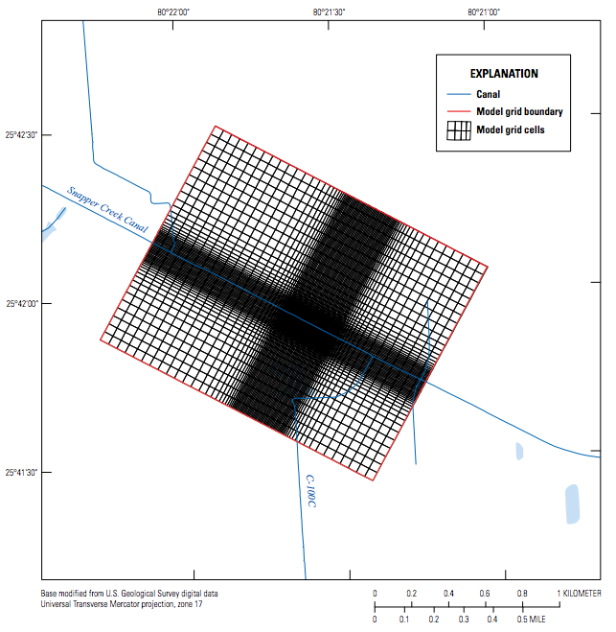
A Framework for All Scales
regional/state
continental
county/subregional
municipal
site
Notes:
NRP Continental groundwater model – 65 models, single layer, 300 m resolution,
Unique at USGS compared to consultants and other govt agencies in that we work over many different scales.

Slide 18
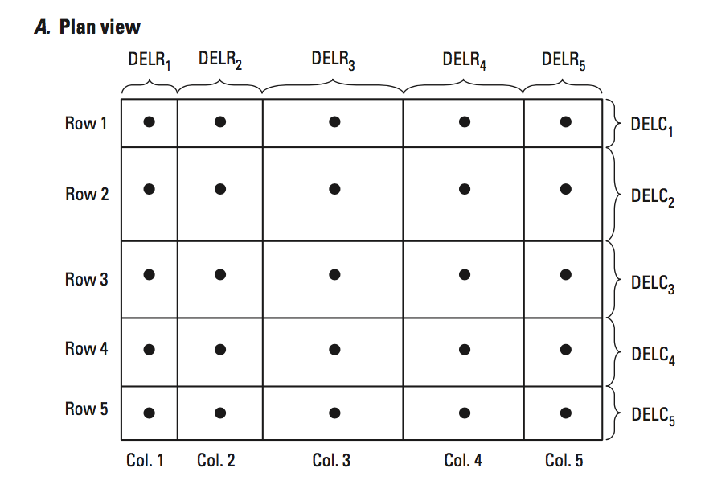
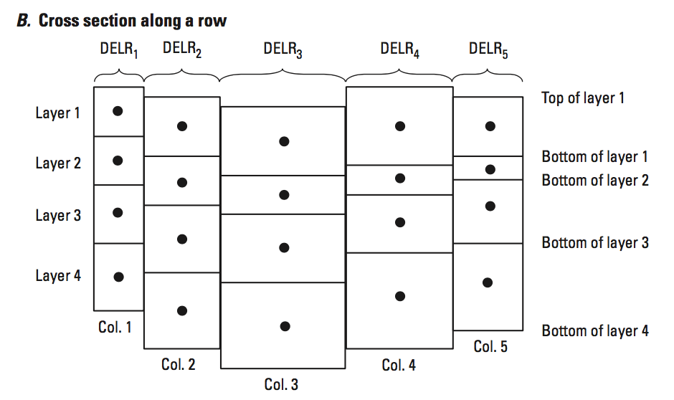
MODFLOW Regular Grid

Slide 19
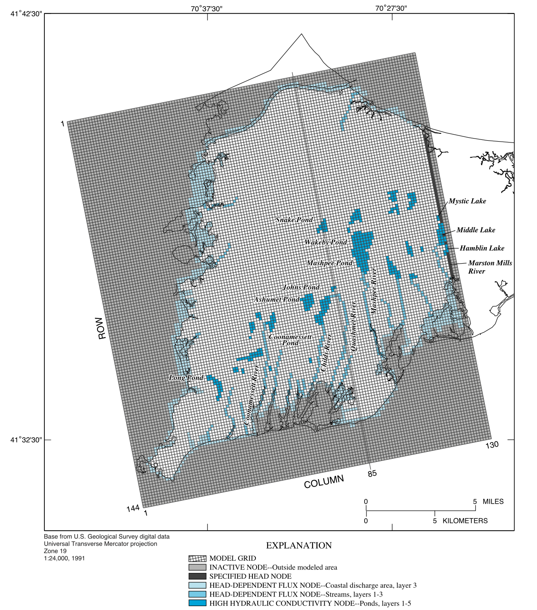
Model Grid

Slide 20
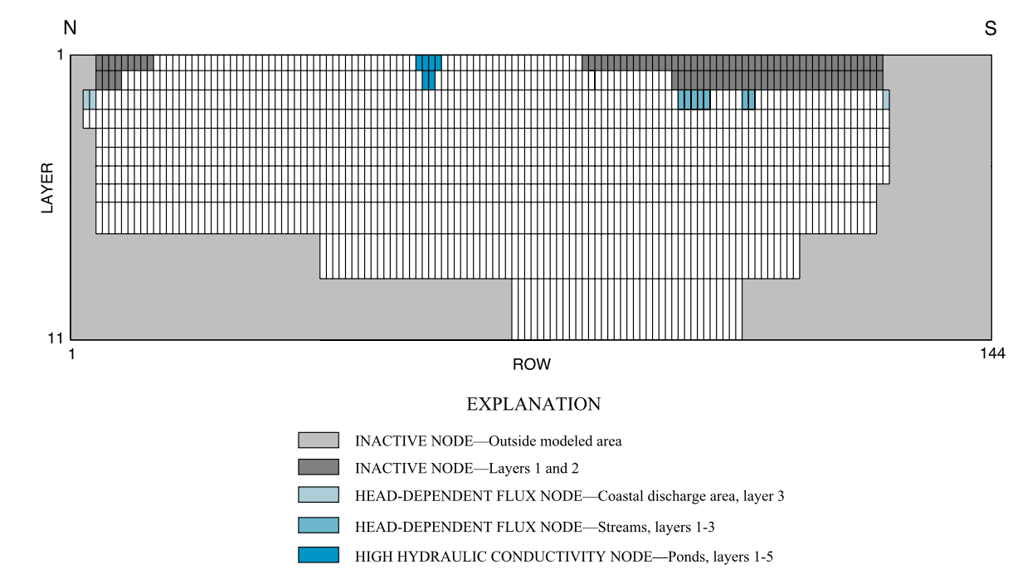

Slide 21
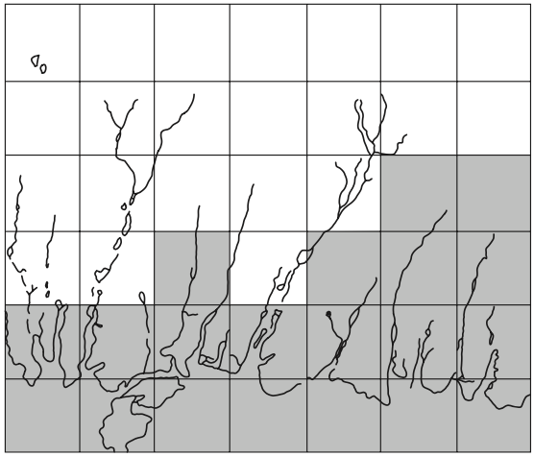
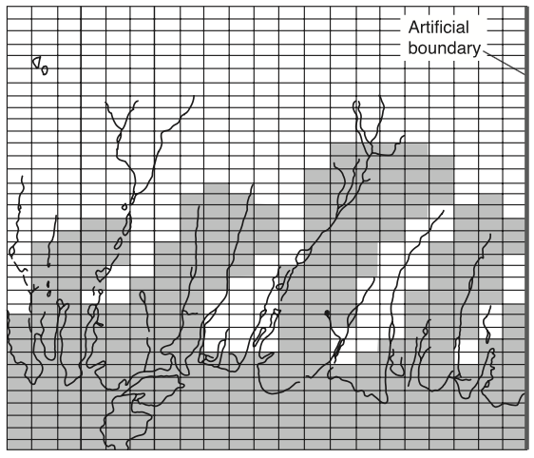
Resolution

Slide 22
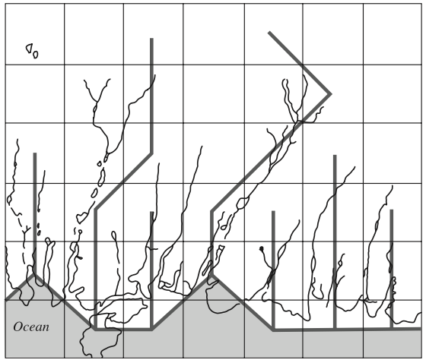
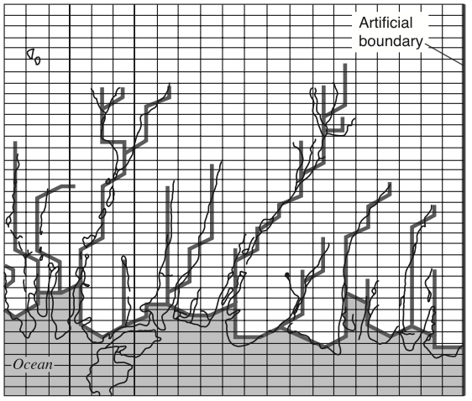

Slide 23
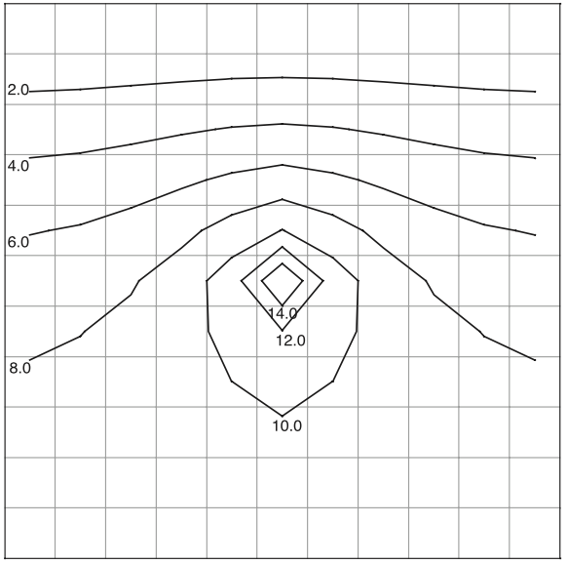
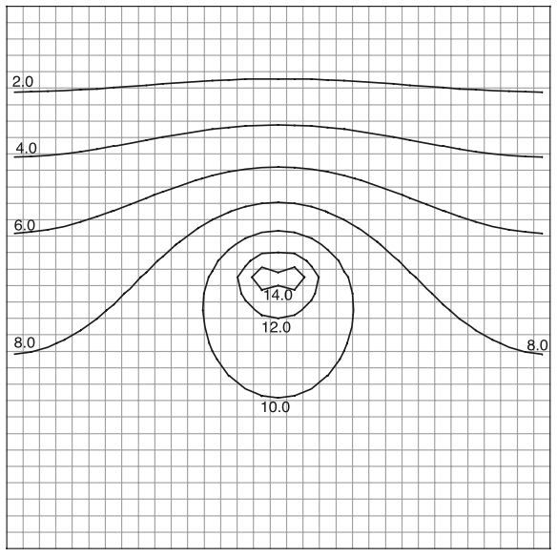

Slide 24
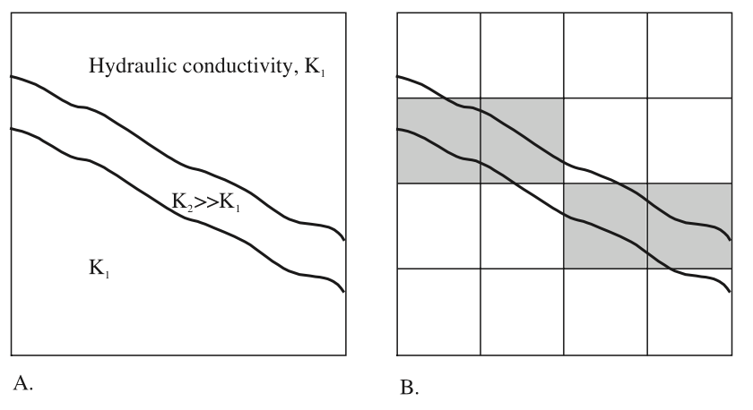

Slide 25
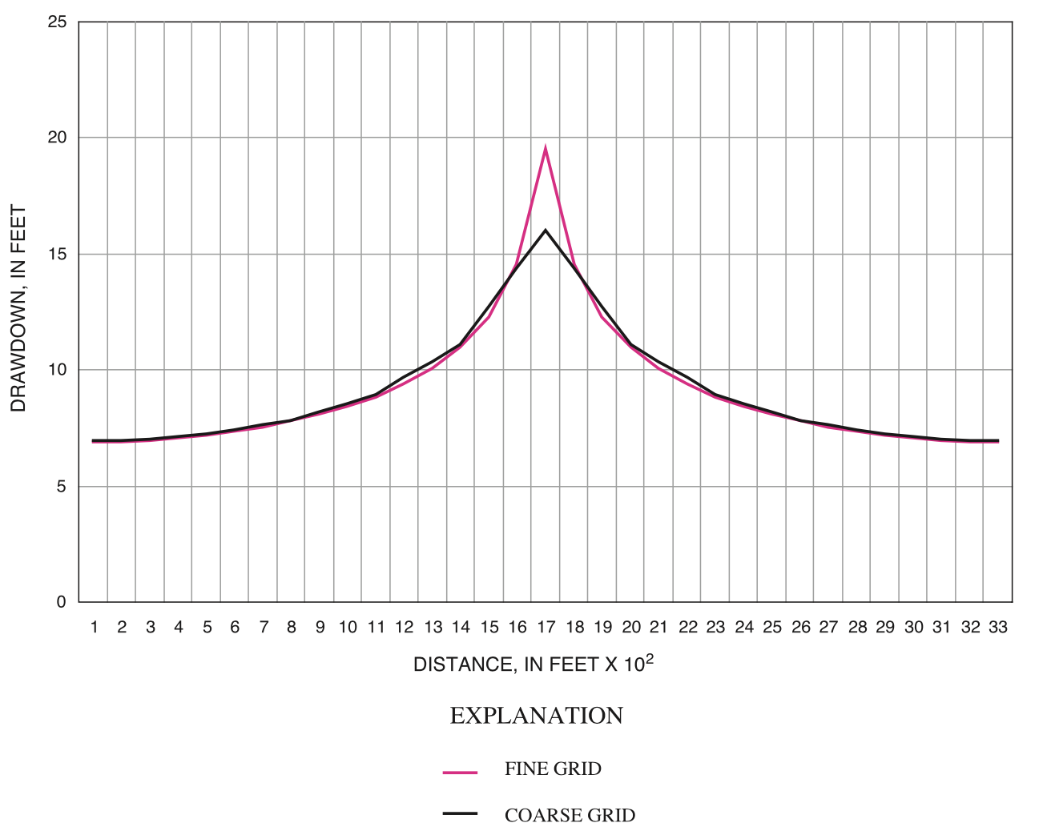

Slide 26
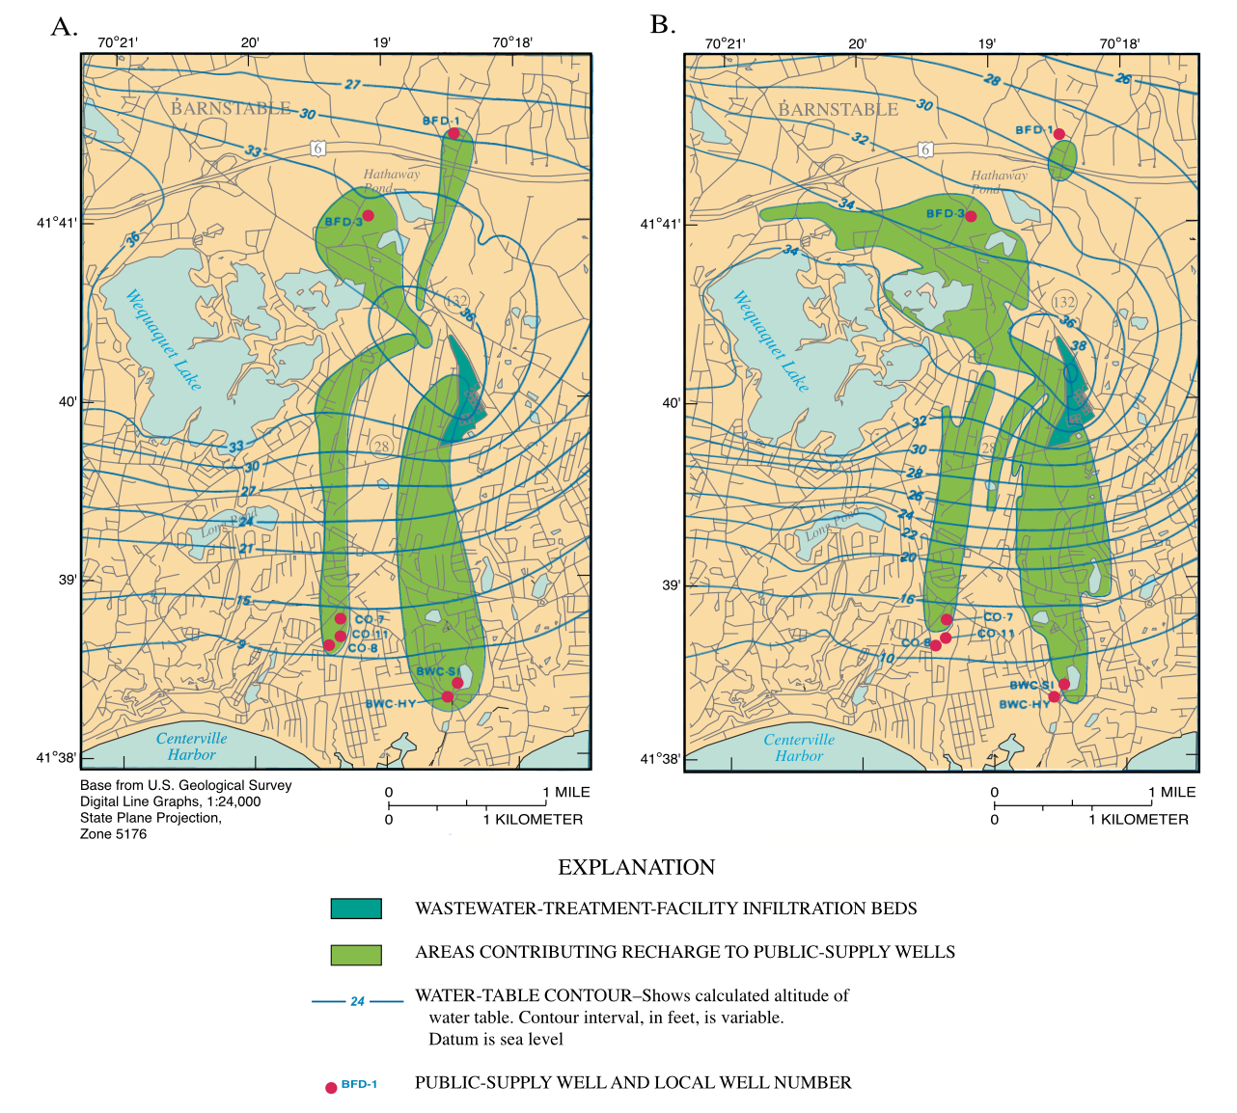
2D or 3D?

Slide 27
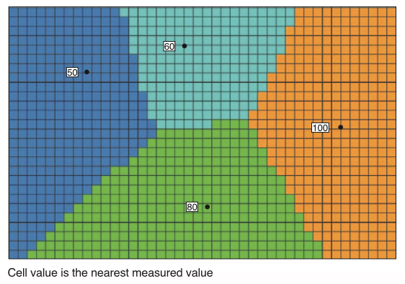
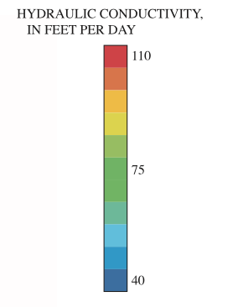
Assigning Values

Slide 28
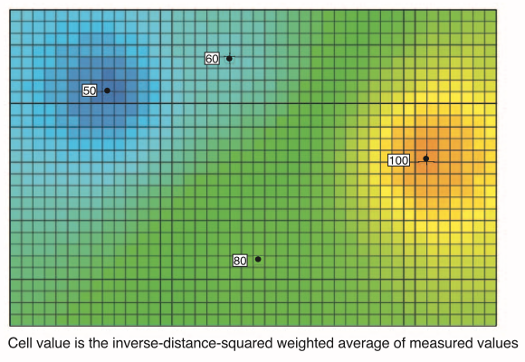
Assigning Values

Slide 29
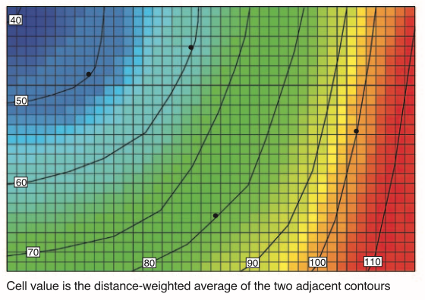
Assigning Values

Slide 30
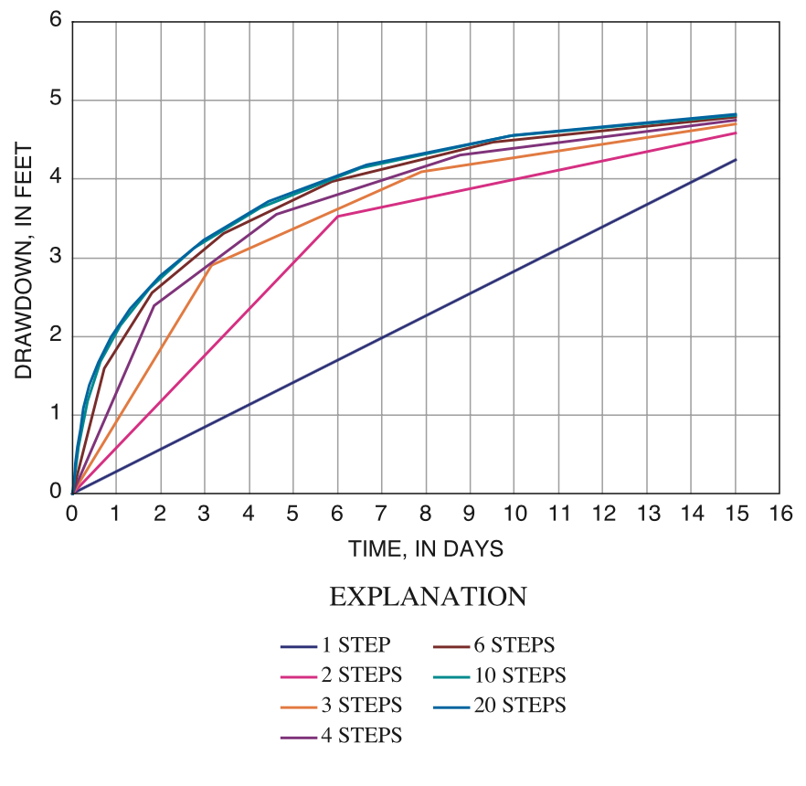
Temporal Discretization

Slide 31
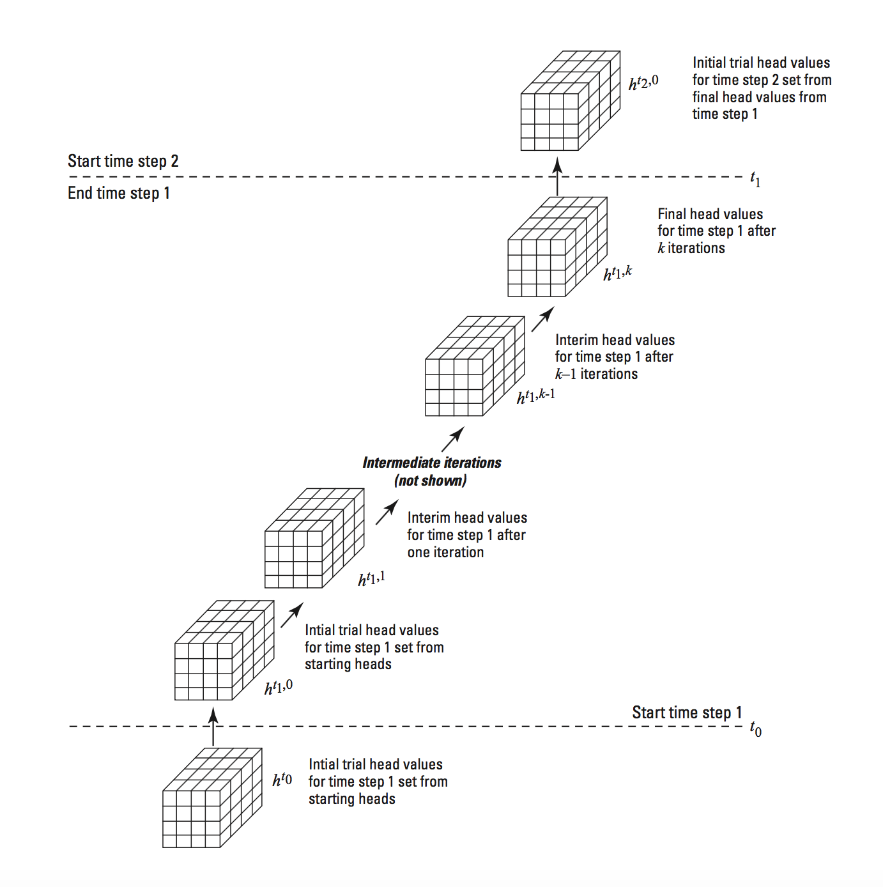
Transient Solution

Slide 32
Calibration

Slide 33
Forecast

Slide 34
Document

Slide 35
